Slide 1
ANXIETY & PANIC ATTACKS

Slide 2
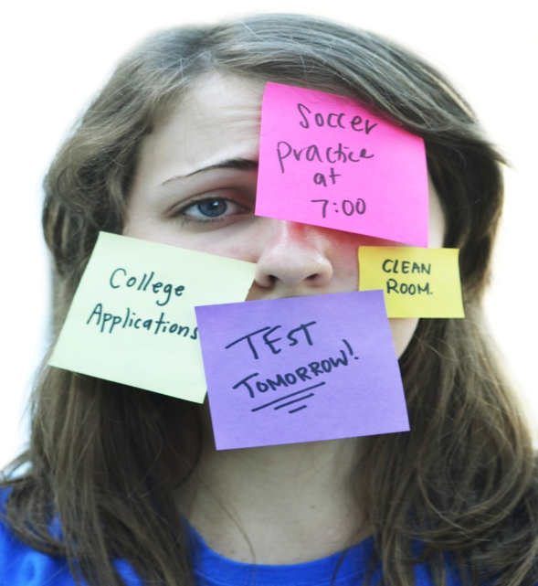
Anxiety
Anxiety disorders involve excessive fear and anxiety that can be displayed in many different ways.
Fear is the emotional response to real or perceived imminent threat, whereas anxiety is anticipation of future threat.

Slide 3
Facts about Anxiety
Anxiety disorders are the most common mental illness in the U.S. (25% of individuals between 13-18 years of age are affected).
Anxiety is highly treatable, but only one-third of those who suffer from it receive treatment!
Depression often accompanies anxiety disorders.
Panic attacks are the most common of ways that people experience anxiety

Slide 4
What is a panic attack?
Thousands of years ago humans lived with constant threat of attack, from members of other tribes or from wild animals.
When attacked, humans either had to run or fight.
The body’ response to this is called the fight or flight mechanism and it’s this ancient programming that causes panic.

Slide 5
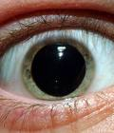
What is a panic attack?
When our fight or flight response is triggered it causes lots of very quick changes in the body, much of them caused by a huge release of adrenaline.
Our heart beats faster and our breathing increases to get more oxygen to our muscles, we may start to shake or our muscles get twitchy to prepare us for action
Panic attacks are when this happens and we are NOT under threat!

Slide 6
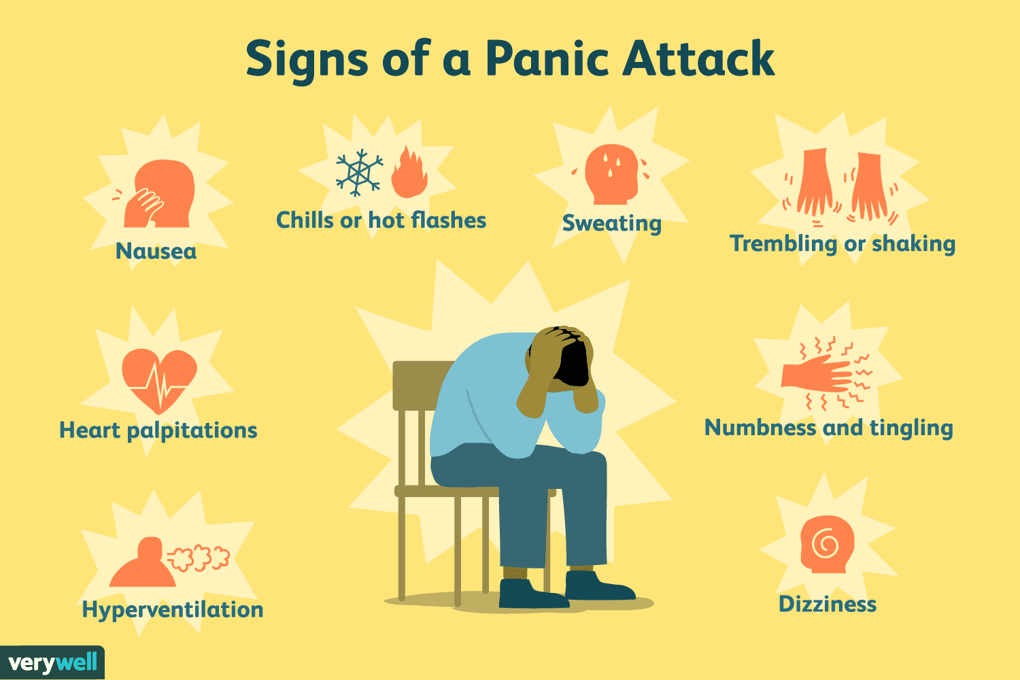

Slide 7
Two Types of Panic Attacks
Expected– we expect these panic attacks when we encounter specific cues or panic triggers. For instance, a person who has fear of enclosed spaces (claustrophobia) may expect to have panic attacks when in an elevator or other small and enclosed areas.
Unexpected– These panic attacks occur suddenly without any obvious reason or “out of the blue.” This can occur when someone is completely relaxed before encountering panic triggers

Slide 8
Panic Attacks Continued…
Watch the following videos about panic attacks:
https://www.youtube.com/watch?v=_qo4uPxhUzU
http://www.youtube.com/watch?v=bORorxMt6rY

Slide 9
Talking Therapies
A lot of people benefit from talking to trained counselors or therapists and there are many different kinds of therapies.
Some are about finding new ways to work through problems and issues and some are about looking at what underlying issues may have caused the anxiety.

Slide 10
An Exercise that may be Helpful When Feeling Anxiety

Slide 11
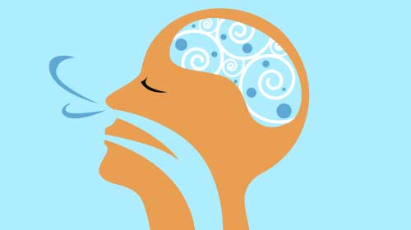
Breathing Exercise
Find a comfortable position in your chair. If you would like, close your eyes; if not, just gaze down at the floor.
Take a few moments to settle yourself. Now become aware of your body.
Check for any tension, beginning with your feet, moving toward your head.
Notice any tension you might have in your legs, stomach, hands and arms, shoulders, neck, and face, Try to let go of any tension.

Slide 12
Breathing Exercise Continued…
Now, become aware of your breathing. Pay attention to your breath as it enters and leaves your body. This can be very relaxing
Take a deep breath. Notice your lungs and chest expanding. Now slowly exhale through your nose. Again, take a deep breath. Fill your lungs and your chest. Notice how much air you can take in. Hold it for a second. Now release it and exhale slowly. Inhale slowly and fully one more time. Hold it for a second, and release.

Slide 13
Breathing Exercise Continued…
Continue breathing in this way for another couple of minutes. Continue to focus on your breath. With each inhalation and exhalation, feel your body becoming more and more relaxed. Use your breathing to wash away any remaining tension.
Now take another deep breath. Inhale fully, hold it for a second, and release. Inhale again, hold, and release. Continue to be aware of your breath as it fills your lungs. Once more, inhale fully, hold it for a second, and release.

Slide 14
Breathing Exercise Continued…
When you feel that you are ready, open your eyes. How was that? Did you notice any new sensations while you were breathing? How do you feel now?
This breathing exercise can be shortened to just 3 deep inhalations and exhalations. Even that can be helpful when your anxiety is escalating. You can practice that at home, at school, at work, or on the bus. The key to using deep-breathing as an effective relaxation technique is to practice it frequently and to apply it in different situations.

