Slide 1
DEPRESSION & SUICIDE

Slide 2
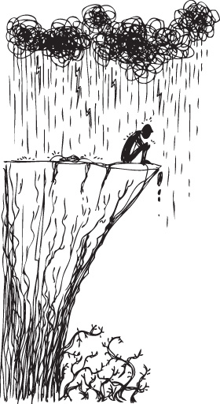
Depression
Teen depression is a serious medical problem that causes a persistent feeling of sadness and loss of interest in activities.
One in three teens with depression also develop a substance abuse problem which may lead to other mental issues and/or jail or prison

Slide 3
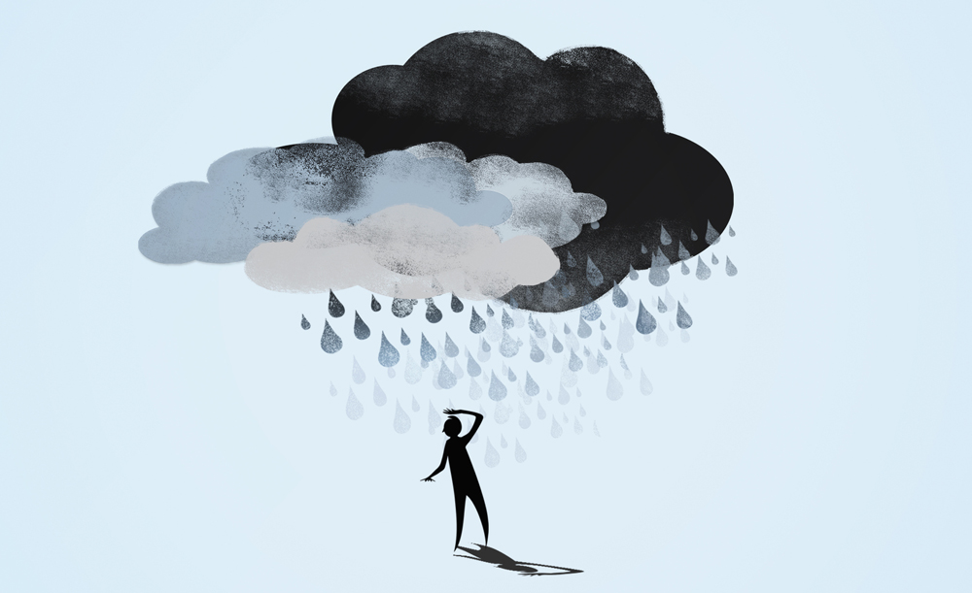
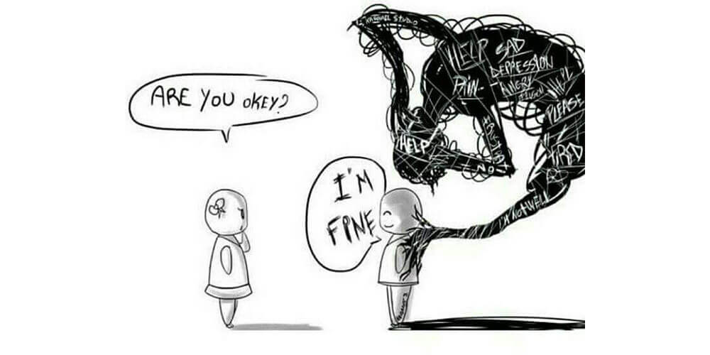
What is depression?
We all feel down sometimes, however, when not related to loss or death, these feelings usually only last a week.
Depression interferes with daily life and causes pain for both you and those who care about you.

Slide 4
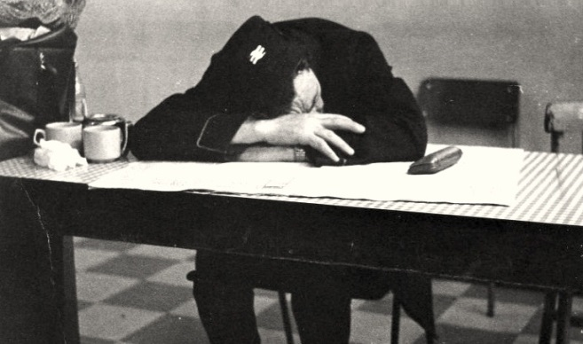
When experiencing depression…
We may feel:
Sad
Anxious
Empty
Hopeless
Pessimistic (negative thinking)
Guilt
Worthless
Helpless
Everyone is affected differently. Some may be able to continue with work and/or school even though it requires a huge amount of effort, while others may be overwhelmed and may be suicidal.

Slide 5
When to Get Help
Feeling down is normal, especially after experiencing loss or when going through difficult times.
When depression makes day to day living seem difficult or impossible, when feelings of despair last longer than a few weeks, or if we feel like wanting to hurt ourselves or others, we need to seek help immediately!

Slide 6
Depression
The following videos are about depression:
http://www.youtube.com/watch?v=S1PPCzRkBKQ
http://www.youtube.com/watch?v=MiS02j3zt68

Slide 7
Teen Suicide
SOME WARNING SIGNS
You notice a classmate begins drinking alcohol and/or using drugs
Your classmate talks about suicide or wanting to die
Your classmate becomes angry and irritable and/or becomes very moody
Your classmate begins giving away his or her belongings

Slide 8
What do I do?
Ask your classmate if they are thinking about hurting themselves.
Support them.
Connect them with a trusted adult.
Teachers, counselors, parents or guardians
If unwilling– Tell someone!
National Suicide Prevention Lifeline:
1(800) 273-8255

Slide 9
What can we do?
Depression is very common and there is a wide range of support available.
Information on local support groups, counselling services, stress management courses, alternative therapy centers, etc. can be found in local libraries, at healthy living centers, or online.
www.talking2ourselves.com

Slide 10
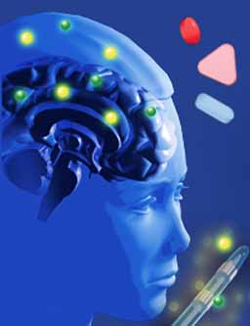
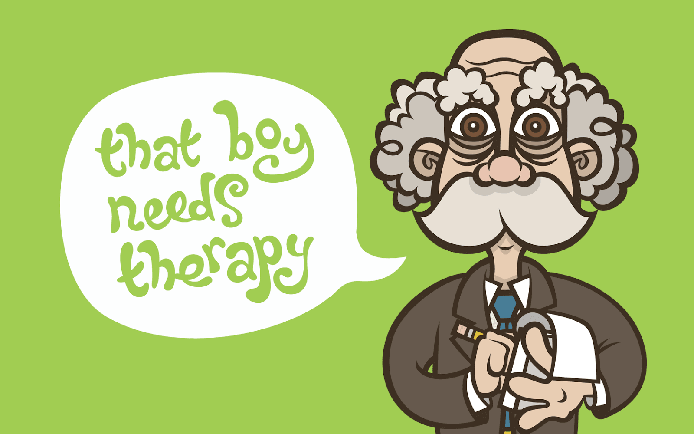
Medical Treatment
Most people seeking treatment for depression will be treated by their family doctor.
He/she may prescribe antidepressants.
Antidepressants alter the chemical balance in your brain to improve mood.
They can give you valuable “breathing space,” getting you to a level where you can function well enough to tackle the problems that may be causing the depression.
Your doctor may refer you to see a counselor, psychologist or other mental health professional.

Slide 11
Talking Therapies
A lot of people benefit from talking to trained counselors or therapists and there are many different kinds of therapies.
Some are about finding new ways to work through problems and issues and some are about looking at what underlying issues may have caused the depression.

Slide 12
Exercise
Exercise boosts our feel good hormones and general health, increasing our sense of self worth.
Therapists highly encourage some form of exercise at least 3-4 times a week.

Slide 13
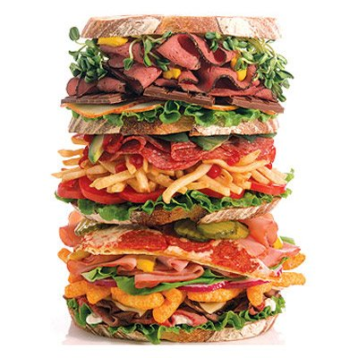
Balanced Diet
There are links between depression and poor diet.
Both diet and exercise are part of generally looking after yourself, and is particularly important when you are depressed.

Slide 14
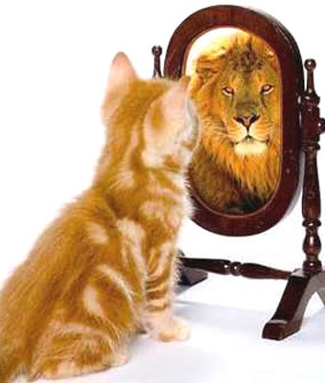
Self-Esteem Boosting Activities
Taking part in activities which make you feel good have a crucial role in working through depression.
Depression can lower our confidence and causes us to isolate ourselves away from our friends and family.
Making new friends, finding new interests, hobbies and passions all help boost self-esteem and feelings of well-being and self-worth.

Slide 15
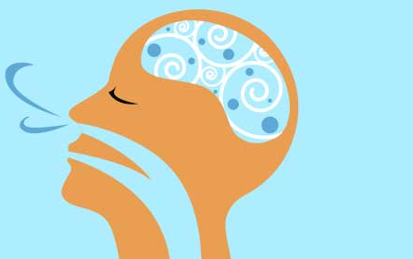
Breathing Exercise
Find a comfortable position in your chair. If you would like, close your eyes; if not, just gaze down at the floor.
Take a few moments to settle yourself. Now become aware of your body.
Check for any tension, beginning with your feet, moving toward your head.
Notice any tension you might have in your legs, stomach, hands and arms, shoulders, neck, and face, Try to let go of any tension.

Slide 16
Breathing Exercise Continued…
Now, become aware of your breathing. Pay attention to your breath as it enters and leaves your body. This can be very relaxing
Take a deep breath. Notice your lungs and chest expanding. Now slowly exhale through your nose. Again, take a deep breath. Fill your lungs and your chest. Notice how much air you can take in. Hold it for a second. Now release it and exhale slowly. Inhale slowly and fully one more time. Hold it for a second, and release.

Slide 17
Breathing Exercise Continued…
Continue breathing in this way for another couple of minutes. Continue to focus on your breath. With each inhalation and exhalation, feel your body becoming more and more relaxed. Use your breathing to wash away any remaining tension.
Now take another deep breath. Inhale fully, hold it for a second, and release. Inhale again, hold, and release. Continue to be aware of your breath as it fills your lungs. Once more, inhale fully, hold it for a second, and release.

Slide 18
Breathing Exercise Continued…
When you feel that you are ready, open your eyes. How was that? Did you notice any new sensations while you were breathing? How do you feel now?
This breathing exercise can be shortened to just 3 deep inhalations and exhalations. Even that can be helpful when your anxiety is escalating. You can practice that at home, at school, at work, or on the bus. The key to using deep-breathing as an effective relaxation technique is to practice it frequently and to apply it in different situations.

Slide 19
Self Help
There are a huge range of self help books, CDs, DVDs and online courses for overcoming depression.
The local library or Internet is a good place to start.

Slide 20
How can we maintain good mental health?

